Slide 1
HTML 5
Working with Links

Slide 2
Working with Links

Slide 3
Working of hyperlinks in web pages
Links allow users to navigate and find information on the Internet as easy
as possible.
HTML links are hyperlinks.
A hyperlink is a text or an image you can click on, and jump to another
document.
Tag to create a link is <a> which stands for anchor.
Syntax: <a href=“url”>link text </a>
By default, links will appear as this in all browsers:
An unvisited link is underlined and text is highlighted in blue color (Click me)
A visited link is underlined and text is highlighted in purple color ( Click me )
An active link is underlined and text is highlighted in red color ( Click me )

Slide 4
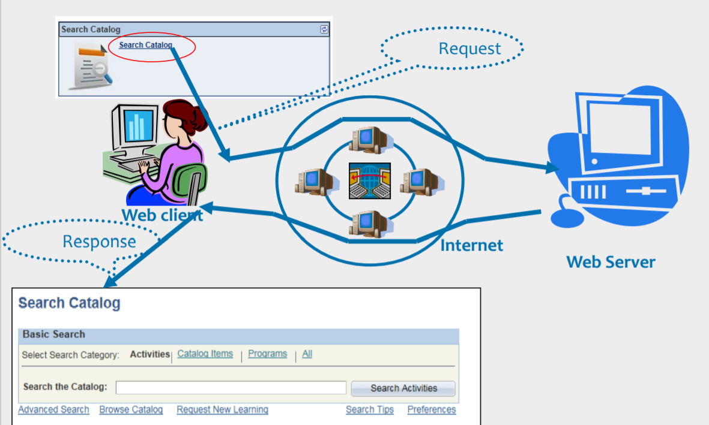
How does Hyperlink works?

Slide 5
Create hyperlinks in web pages

Slide 6
Create Links
Link to local document in an application(Relative linking)
<a href=“contactus.html”>Click Here</a>
Link to local document in an application(Absolute linking)
<a href=“http://localhost:8080/Example/contactus.html”
>Click Here</a>
Link to web document
I have some <a href=“http://www.state.edu/info/info.htm”>
information</a> about education.

Slide 7
Links to an E-Mail
Link to an electronic mail:
An URL tag called “mailto” identifies the address to which an e-mail
has to be sent.
Syntax:
<a href=“mailto:mailid?subject =content&cc=ccmailid&bcc=bcc-mailid”>Link text</a>
<a href=“mailto:eDude@igate.com?subject =More
Info”>Contact Me</a>
Please <a href=“mailto:author@igate.com>mail</a>your
comments to me

Slide 8
CC and BCC in Email (Code)
<!DOCTYPE html>
<html>
<body>
<!----add the CC and BCC's--->
<a
href="mailto:edude@capgemini.com?Subject=Hello&Cc=jane@cap
gemini.com&bcc=joe@capgemini.com"> Mail us </a>
</body>
</html>

Slide 9
Links to Specific Part of a Page
id attribute, used in the anchor tag identifies a section of a page.
Set HREF to the section name. Precede the name with a # symbol
<a id=“address1”></a>
XYZ Ltd, Bagmane Tech Park MTB , Outer Ring Road , Mahadevpura
Bengaluru 560067. INDIA.
…Contents of the page…
I am working in <a href=“#address1”>XYZ</a>

Slide 10
DEMO
Linkall.html

Slide 11
Providing Target for a Hyperlink
Target attribute of the <a> tag specifies where to load the linked document.
<a href=“link2.htm” target=“frame2”>Document 2</a>
It takes following values:
name of the existing window/target
_blank
_self
_parent
_top
By default it loads the linked document in the current window.

Slide 12
_blank (Code)
Target attribute of the <a> tag specifies where to load the linked document.
<a href=“link2.htm” target=“frame2”>Document 2</a>
It takes following values:
name of the existing window/target
_blank
_self
_parent
_top
By default it loads the linked document in the current window.

Slide 13
_self (Code)
“_self”:
Puts new document in the same window and frame as the current document.
Works the same as if you had not used TARGET at all.
This code produces this go to:
<a href="selftarget.html" target="_self">next</a> page

Slide 14
_top (Code)
“_top”:
loads linked document in the topmost frame. This means that the new page fills the entire window.
This code produces this go to:
<a href="selftarget.html" target="_top">top</a> page

Slide 15
_parent (Code)
“_parent”:
Used when a frameset file is nested inside another one
A link in one of the inner frameset documents which uses "_parent" loads the new document where the inner frameset file had been
<a href="bigframe.html" target="_parent">bigframe</a>

Slide 16
DEMO
Linktarget.html

Slide 17
Add hyperlinks to list items and table contents

Slide 18
Hyperlinks in Lists Items (Code)
Add links to list items and table contents:
<ul>
<li><a href=home.html>mumbai</a></li>
<li><a href=home.html>pune</a></li>
<li><a href=home.html>nasik</a></li>
</ul>

Slide 19
Hyperlinks in Table Elements (Code)
Add links to table contents:
<table border=1>
<tr><th>team<th>points<th>grade</tr>
<tr><td>
<a
href=home.html>mumbai</a></td><td>90</td><td>a</td>
</tr>
<tr><td>
<a href=home.html>pune</a></td><td>86</td><td>b</td>
</tr>
<tr><td>
<a href=home.html>nasik</a></td><td>80</td><td>c</td>
</tr>
</table>

Slide 20
DEMO
Linkintable.html

